Slide 1



THE FUTURE OF CRYPTOGRAPHY
Created by Kennedy Tan; Index No. 15900322
PSB7031CE Cryptography

Slide 2
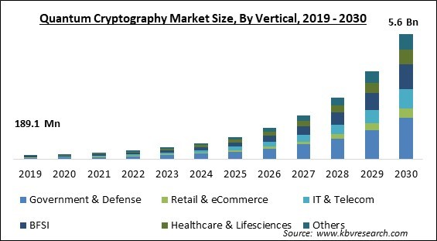
INTRODUCTION
The security of internet will be affected by quantum computing; hence, requiring quantum cryptography.
From KBV Research (2023)

Slide 3
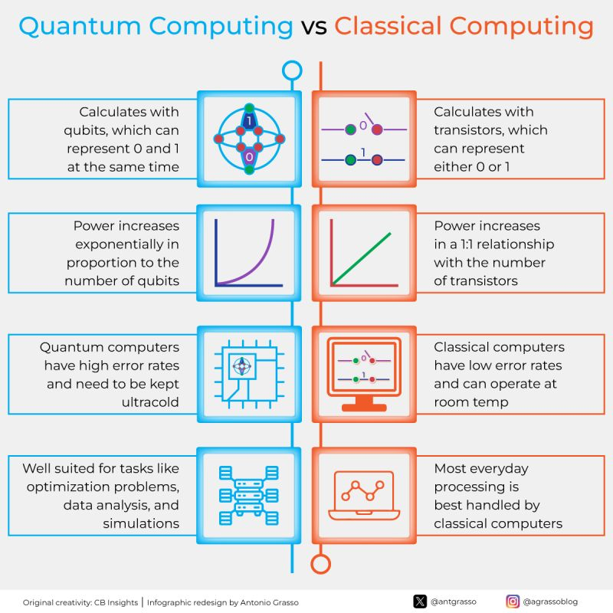
From Grasso (2024)

Slide 4
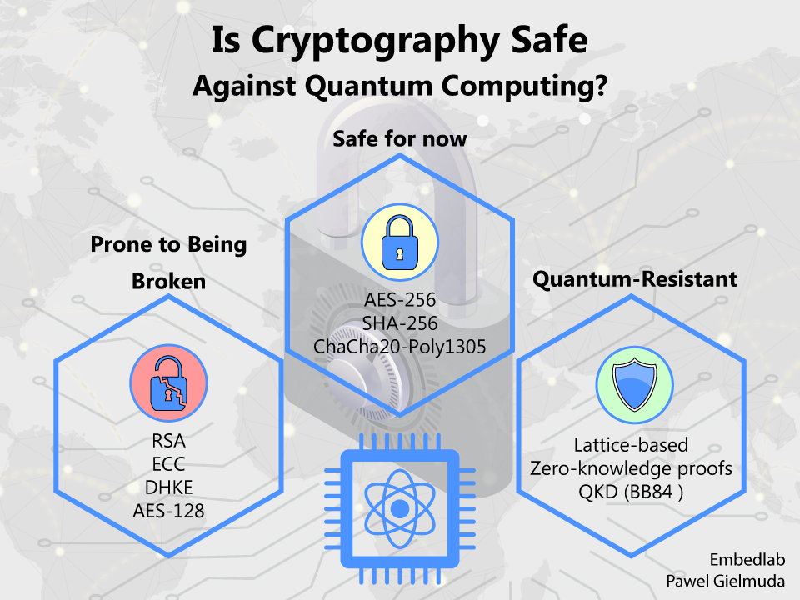
FUTURE OF CRYPTOGRAPHY
AI-Powered Cryptography Design and Security Hardness
01
AI will craft entirely new cryptographic protocols.
Discover new mathematical hardness assumptions.
The trust and auditability will depend on explainable AI (XAI).
Risk: AI can accelerate brute-force attacks.
Practical Information-Theoretic Security
02
Beyond QKD, this exploits inherent randomness and fundamental physical properties of communication channels.
E.g., wireless channel randomness and directional modulation to achieve unconditional security.
(-) Strict Channel Requirements.
From Gielmuda (2023)

Slide 5
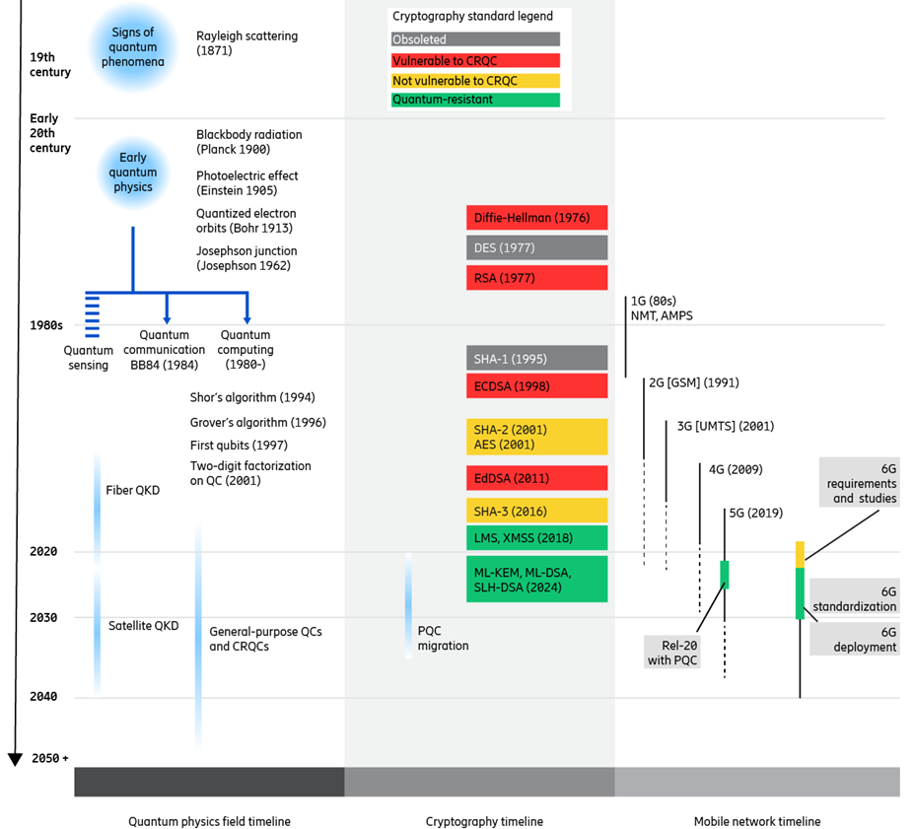
QUANTUM TIMELINE
Quantum started back in the 19th Century.
2025 starts migration to PQC, QKD, and 6G.
Drug Discovery: The simulation of molecular interactions to develop new medications more rapidly and precisely.
From Ericsson (n.d.)

Slide 6

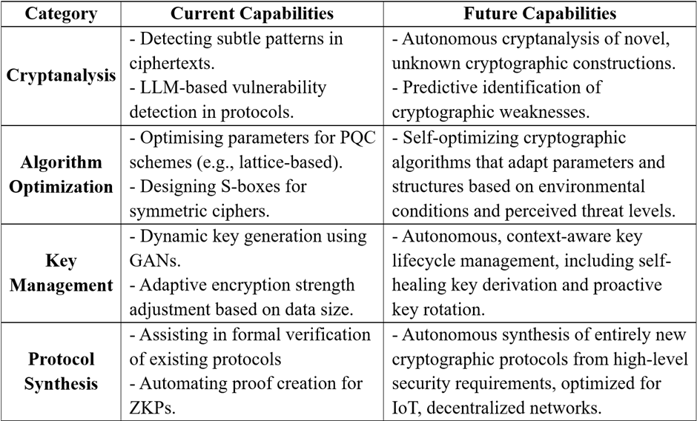
AI-POWERED CRYPTOGRAPHY DESIGN
The integration of AI and ML in cryptanalysis helps to detect subtle patterns, optimise algorithms, and discover vulnerabilities.
DeepDistinguisher algorithms distinguish and classify structured codes more effectively in code-based cryptosystems (Malhou et al., 2025, p.2).
AI could be leveraged for the automated discovery of new mathematical hardness.
Explainable AI (XAI) for humans to understand why the AI made certain design choices and the identified potential weaknesses.
From Giles (2019)
AI in Cryptography: Current vs Future Capabilities

Slide 7
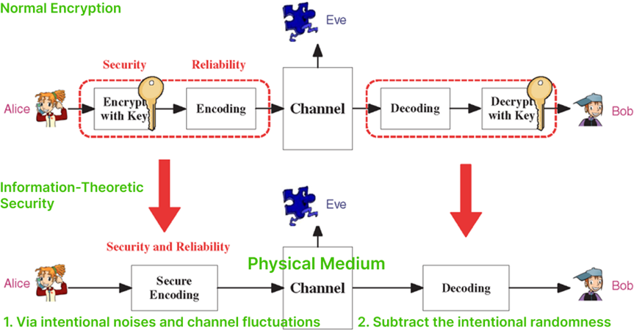
PRACTICAL INFORMATION-THEORETIC SECURITY
QKD Limitations
A partial solution for key exchange, addressing only key distribution.
Requires specialised hardware and dedicated physical links, like optical fibres with around 100 km maximum range.
Future Information-Theoretic Security:
Leverage the inherent randomness present in the physical wireless medium, such as noise and channel fluctuations due to fading.
Find the differences between legitimate and eavesdropper channels to securely transmit confidential messages.
Adapted from Liang et al. (2009)

Slide 8
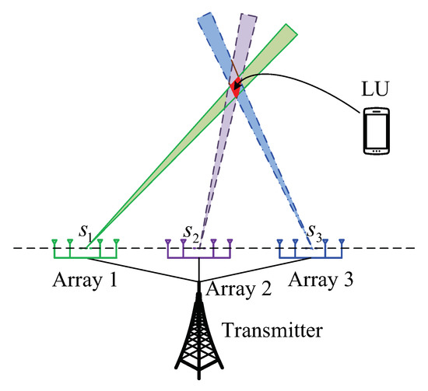
PRACTICAL INFORMATION-THEORETIC SECURITY
The future also perhaps will utilise Directional Modulation and Near-Field Direct Antenna Modulation (NFDAM).
This employs techniques like parasitic or phased arrays to independently control transmitted modulation in different or undesired directions.
The results are modulations that are difficult to decode, which achieve secrecy by design at the physical layer itself.
From Zhang et al. (2019)

Slide 9
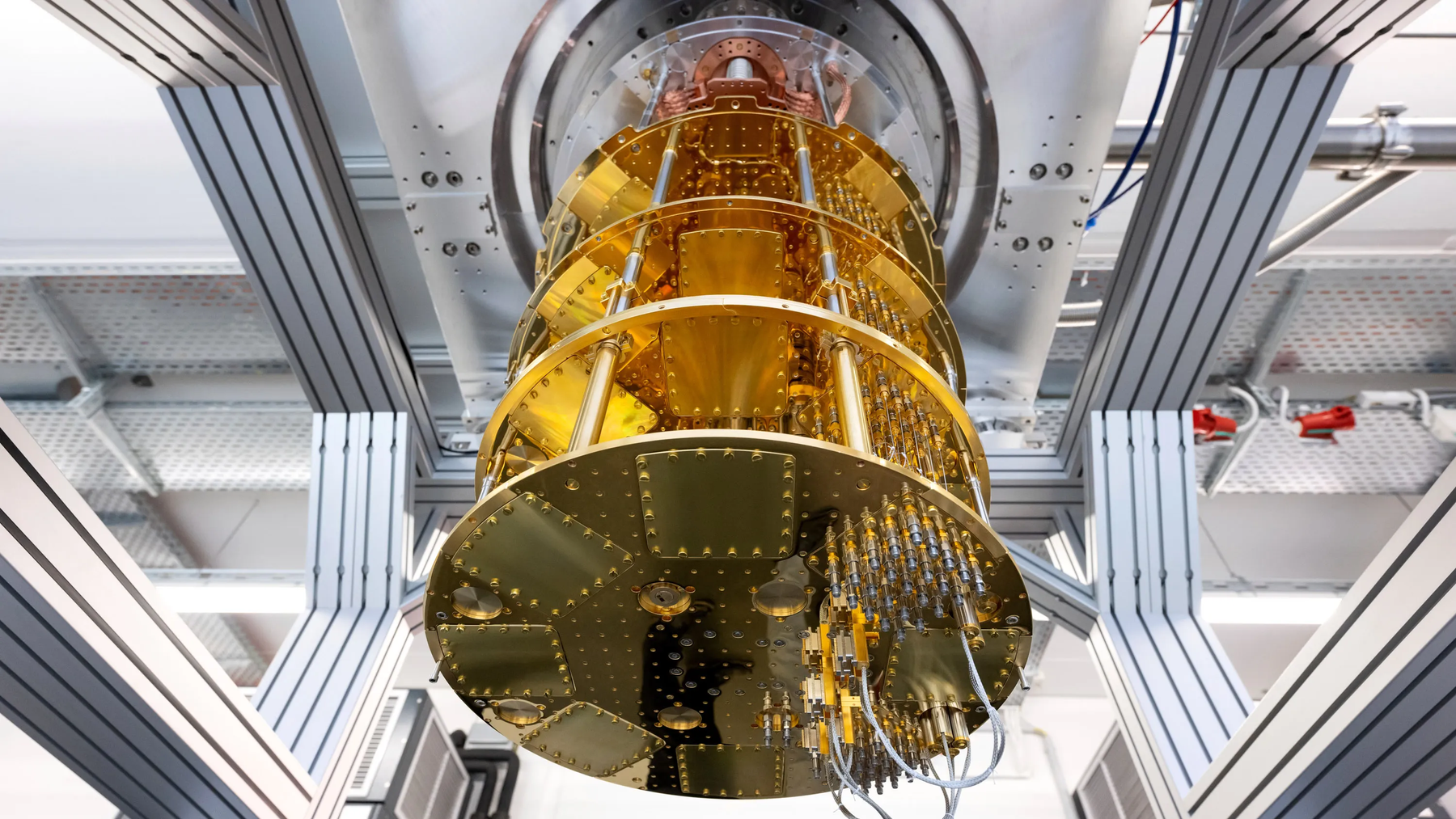
CONCLUSION
The transition towards Post-Quantum Cryptography (PQC) is necessary to maintain the security of digital communications and the Internet (Khan, 2025, p.5).
Nevertheless, PQC algorithms require larger key sizes; unsuitable for IoT and resource-constrained devices.
AI and machine learning are used for cryptanalysis to detect subtle patterns and vulnerabilities.
Information-Theoretic Security represents a profound shift to physics-hardness that is unbreakable even with infinite computational power due to fundamental physical laws.
From Xu (2022)

Slide 10


PSB7031CE Cryptography
From Bits to Qubits,
From Classical to Quantum
Thank you for your attention.
Hopefully this presentation has provided valuable insights into cryptography future.
Created by Kennedy Tan; Index No. 15900322

Slide 11
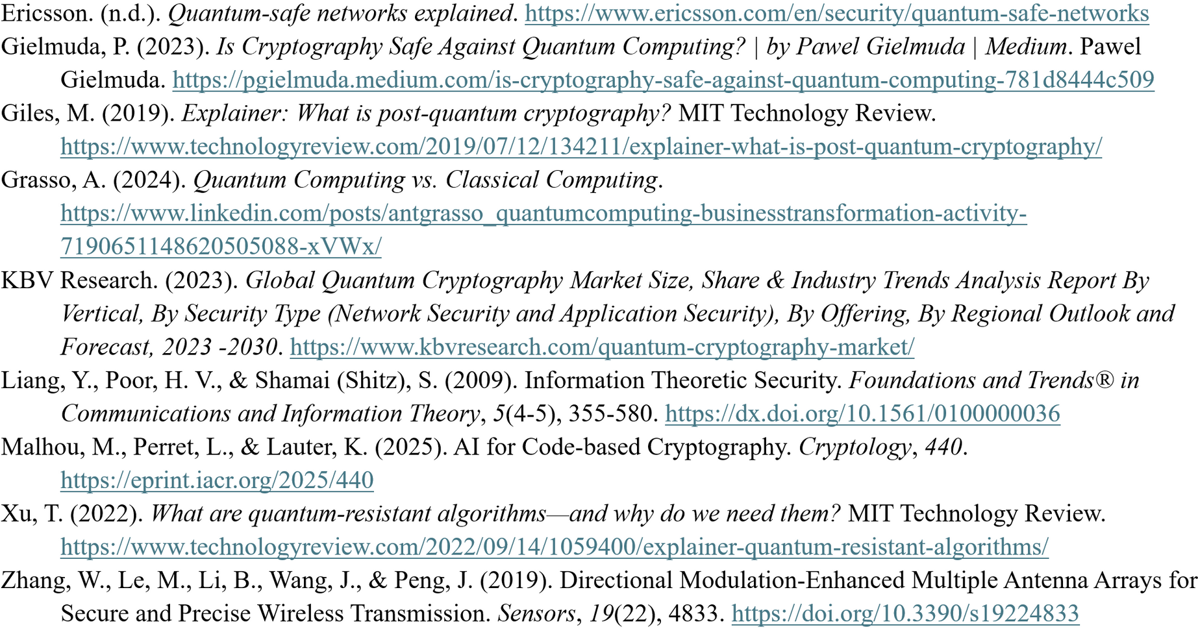
REFERENCES
14

